Slide 1
Digital Media Database
By Jonathan Trahan, Emily Hollis, Ben Young

Slide 2
Area of application - Recommendations
When people want to find a movie to watch, but are uncertain about what movies there are and how favorable others view it.
Movies are divided by genre(s) and ordered by popularity, and/or time of release.
Users with accounts can leave a rating between 0.0-5.0 starts, and a written review of the movie.

Slide 3
Challenges in storing data
Movies are categorized by, Genre(s)(Action, Mystery, etc.), viewer ratings, # of reviews, age rating, and release date.
Users can view Movie info, ratings, and review
Users can post reviews of media while also rating them between 0.0-5.0 stars.

Slide 4
Need for Application
Keeps track of movies that have been produced
provide reviews for users to decide what movies they want to watch
allow users to write reviews for movies they have watched
provide information that will allow users to have a better movie experience

Slide 5
entities
Movies
user

Slide 6
Relationships between entities
users write reviews
movies have reviews

Slide 7
Constraints enforced
movies need a title
reviews belong to a movie
users can have one review per movie
a review needs a rating and content

Slide 8
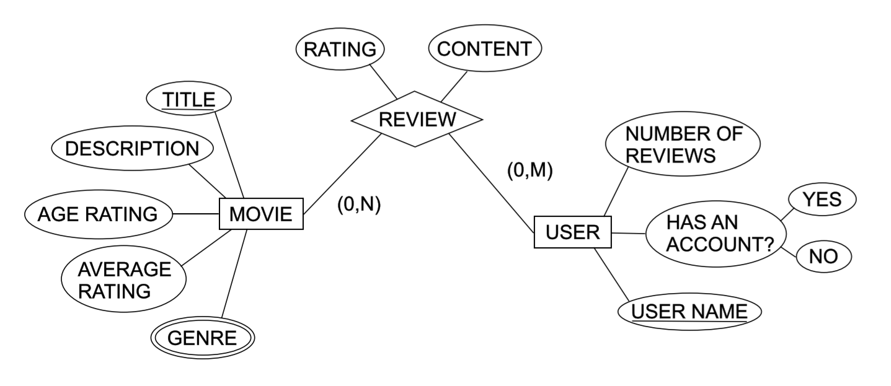
Suggested Entity Relationship (E/R) Model

Slide 9
Suggested Entity Relationship (E/R) Model
MOVIE =(title, description, age_rating, avg_rating, genre)
REVIEW=(rating, content)
USER = (username, num_of_reveiws, has_account)

Slide 10
Explain Constraints
Every movie has to have a title and description
Each review has to have a number rating and a description for that rating
Each movie has to have an age rating
Every movie has a list of genres
Each user has a number representing how many movies they have reviewed

Slide 11
Explain Constraints
A movie can have no more than 4 genres
Each user is only allowed to rate each movie once
a user must have an account in order to post a review

Slide 12
Timeline
Planning | Collect Data | Create Commands | Make User-Interface
1/2 week | 1/2 week | 2 weeks | 2 weeks
Every group member will work on each part equally.

